Slide 1
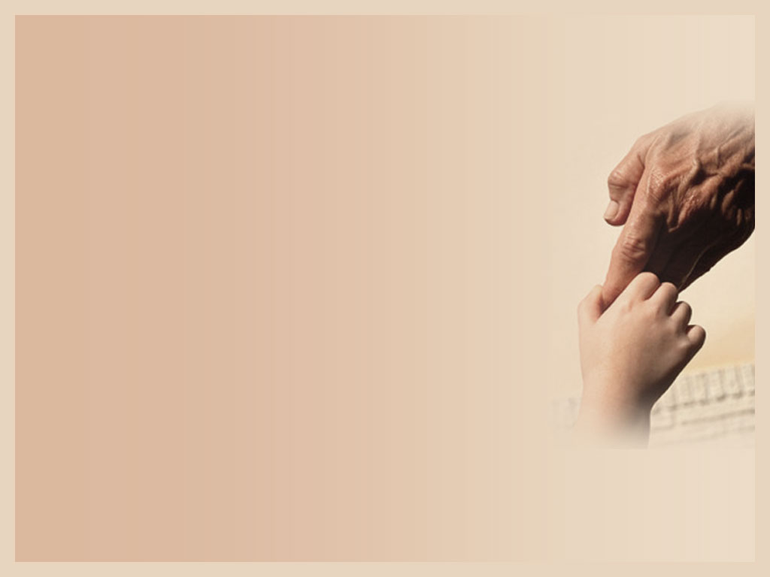
Healthy Boundary
Key to Freedom
By Pastor Teresa Tong
October 09, 2013

Slide 2
Healthy Boundary
What is a Boundary???
??? Boundary???

Slide 3
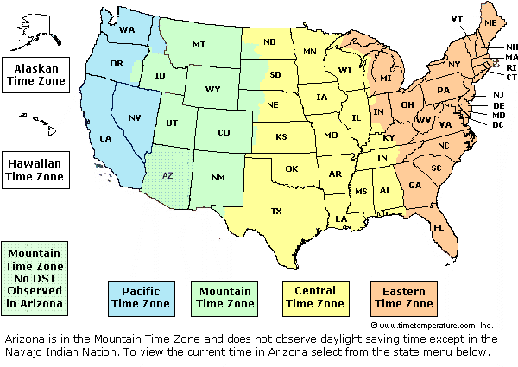
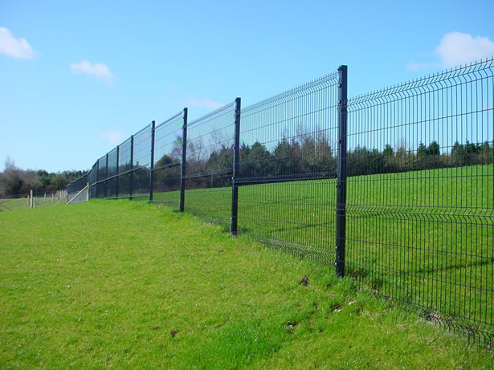

Slide 5
What is a Boundary??
A boundary is a property line where one person ends and someone else begins
Notes:
Goal of Parenting is to keep an eye on the future, raising our children to be a responsible adult. If a person’s character makeup determines his future, then child rearing is primarily about helping children to develop character that will take him through life safely, securely, productively and joyfully
Definition of boundaries = a property line where one person ends and someone else begins.
Children are not born with boundaries so parents have to help them learn boundaries: - have a sense of who they are - what they are responsible for - ability to choose - understand the effect of reaping corresponding consequences - understand true love based in freedom - internalize boundaries that were initially external to him

Slide 6
Boundary Problems
Easily manipulated/ controlled
Inability to say NO to hurtful people
Experiencing life as a victim
Inability to confront others to resolve conflicts productively
Notes:
Boundary problems: - inability to say no to hurtful people - inability to say no to own destructive impulses - inability to hear no from others - inability to delay gratification - try to fix irresponsible people - easily manipulated / controlled - struggle with intimacy, maintaining closeness with others - inability to confront others and resolve conflicts productively - experiencing life as a victim - addiction and compulsion - disorganized and cannot follow through - try to control others and being out of control of herself **

Slide 7
Boundary Problems
Inability to hear NO from others
Disorganized and cannot follow through
Try to control others
Addiction and compulsion
Inability to delay gratification

Slide 8
Benefits of a Healthy Boundary
Loving
Responsible
Free
Initiating
Respectful for Reality
Growing
Notes:
Setting boundary helps to develop these characters: loving,
Loving ➔- Egocentric = thinking that they are all that matters and people around them exist only to meet their demands and needs. - Most loving parents end up with the most selfish children due to lack of boundary as they receive no negative effect when they did not perform - A controlling person steps over the line and tries to possess the others, may lead to marriage problems
Responsible - A responsible person takes ownership of their feelings, attitudes, behaviours, choices, limits, talents, thoughts, desires, values, loves - A truly responsible person realizes “I made me do it and I am responsible” and it will lead to self-control
Free ➔ - Victims feel as if they have no choices in life. They don’t know they are free to make choices in relationships and in life - Children should grow up knowing that they are free to live their lives any way they choose as long as they take responsibility for their choices.
Initiating ➔ - A child needs to take initiation and to take their talents and multiply them and be responsible for their own fun and outcome of their goals
Respectful of Reality ➔ - every person has to come to the realization that one’s actions have real consequences in a real world. If so, he will work with both hope for reward and a desire to avoid painful realities that come from non-performances / poor choices - if a child is bailed out too many times, they may think that consequences are for someone else and not for them - the dual respect for the +ve and –ve sides of reality is referred to as wisdom
Growing ➔ - boundary helps children to develop character that faces obstacles of life with an orientation towards growth, to change instead of getting reality to change. Boundary helps them see what is expected of them and how they need to grow to meet these expectations, e.g. recover from distressing emotions, sustain delay gratification, lose/ grieve well, confess when wrong, change direction under confronted reality, forgive, take ownership of a problem.

Slide 9
Roles of Parents
Guardian (to provide them with a safe learning environment and to protect them from dangers)
Manager (discipline them to meet goals)
Source (too much➔ entitlement/self-centred too tight➔ no motivation for goals
Notes:
Parents have 3 main functions: Guardian, Manager, Source
Guardians – responsible to provide the child with a safe learning environment and protect them from dangers but if there is too little freedom to experience, the child always remains as a child, so parents need to rear a child with a good balance of freedom and limits. Eventually the child internalizes the limits as wisdom and starts to take care of himself.
Manager – discipline and mobilize the child so that goals are reached and expectations are met. It can be achieved by controlling resources, teaching, enforcing consequences, correcting, and building skills. Setting limits require the child to take ownership of his problem and be responsible for what he has.
Source – Parents provide the child with resources but if they give without boundaries, the child will become entitled, self-centred, demanding, ungrateful. If parents hold resources too tight, the child will give up, and have no hope or motivation of reaching goals for the rewards

Slide 10
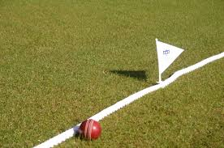
3 Ways to Develop Boundary
Teaching
Modeling
Internalizing
Notes:
3 ways to influence children to develop bounday: Teaching, Modeling, Internalize
Teaching - Use the word “Boundary” with our kids and let them know the consequence of crossing that boundary so that they are responsible for their behaviour and will not push the blame on someone else - Age 1-3, able to understand the word “No” and the consequence of disobedience - Age 3-5, understand the reason and consequence (time out, loss of toys/activity) - Age 6-11, boundary issue ➔ balance time at home vs. outside world, work vs. fun. Consequences (restriction on friendship, freedom, home privileges) - Age 12-18, should begin deparenting, move from controlling to influence
Modeling - Children observe and learn from how we operate with boundaries in our world - If obeying house boundaries help him belong, he will stick to it
Internalize - Internalize = experience it, remember it, digest it, make it part of how they see reality. We are like an oak tree that the child runs his head over and over until he realizes that the tree is stronger than he is, so he will walk around it next time

Slide 11
Obstacles to Teach Boundary
Kid’s job = test our boundary
Parents get worn down
Parents are overly dependent on their kids for closeness
Parents think love and separateness are enemies
Parents think problem will go away
Parents over-identify their pain
Notes:
Obstacles to Teaching Boundaries - Kid’s job=test our boundary, Our job=withstand the test (anger/pouting/tantrum) - Some parents are overly dependent on their kids or overly need the closeness / affection to meet their own unmet needs. When we need their love, it is hard to confront them as we are risking losing the love via withdrawal, anger. The child is emotionally blackmailing the parents as parents dare not cut off the relationship - Parents over-identify with the child’s feeling thinking that they are in great pain, fear and loneliness like a trauma - Parents think love and separateness are enemies. They do not want to jeopardize the relationship so they go along without comment until things really break down. In fact, parents could show to the kids they are two separate people that disagree on the issues but the parents still love the kids deeply and want the best of them. This makes the kids feel secured and develop their freedom under our guidance - Ignoring and zapping the problematic behaviours, hoping that they will go away. Problems not dealt with get worse over time until the parents blow up. Consistency in parents’ boundary is important - Being worn down. Kids may beg, plead, argue for hours until parents give in to what they want. But each time they let them neglect the boundary, the harder they could develop self-control. The trick of parenting is to hold onto our limit one more time than our children hold onto the demand. When kids understand that parents really mean it, they will begin to deescalate their efforts

Slide 12
Sowing and Reaping
True change comes when behaviours cause reality consequences (losing something he values)
Give the child choices but he needs to take the consequence of his choice
When consequence comes, the child (not parent) is responsible to solve it
Notes:
Getting angry, sending guilt messages, nagging, withdrawing love, usually do not motivate people to change or have short-lived change. True change usually comes when someone’s behaviour causes him to encounter reality consequences (e.g. pain, loss of time / money / possession / things he enjoys / people he values)
When someone sows irresponsibility, he will reap the consequence, losing something he values
Steps: 1) no nagging, assuming the child has self-control 2) show no emotional reaction, otherwise parents become a problem 3) do not let the child’s behaviour ruin our life or plan 4) do not agitate the kids’ emotional reactions 5) the consequence should cost the loss of someone or something that he values. Reality loss cause him to change his behaviour.
When consequence comes, parents should not put the –ve outcome on their own shoulder. The child needs to worry about and solve the problems. They should be in control of their own life and not their parents.
Formula: 1) give children freedom, allow choices 2) manage the consequences 3) Give them more freedom and praise/ explain to them why they get increasing freedom, just because they are trustworthiness 4) when they made bad choices, empathize with their loss (e.g. that’s sad not getting to play or I feel for your missing the game or I bet you are hungry, I hate to miss a meal too)
If we don’t empathize but just scold them, they will resent the parents and focus more on hating the parents than on correcting the behaviour Goal = give children the choice to do what they want, but make it so painful for them to do the wrong thing that they will not want to. We are making them choose but making the law of sowing and reaping be actualized. If they sow to responsible behaviour, they will reap the benefits and want to choose that path and vice versa. Parents’ task is to give the proper amount of freedom and choices and then manage the consequences (**)

Slide 13
Sowing and Reaping Formula
Give the child freedom but make it painful for doing wrong
No nagging, show no emotional reaction, don’t agitate his emotion ➔ assuming the child has self-control
Good ➔ praise/increase freedom Bad ➔ Empathize their loss ➔ Stick to the consequence (unless for valid reason)
Notes:
Many parents have difficulty allowing their children to suffer consequences. They interrupt the consequences before they can teach their children the lesson that is designed to teach. The consequences would teach the child a lesson far more cheaply than learning it later in life as no one could bail them out. (e.g. “that’s sad. Seems like I remember this happening with the glue you needed for you last project. Well, I don’t have any, and it is past my bedtime. So I hope you can figure out something to make that does not require glue. Good night, honey”)
Parents need to balance grace (unmerited favour – support, resources, love, compassion, forgiveness) and truth (structure of life telling us how we are supposed to live our lives and how life really works). For the truth to be true to a child, it has to be real and not just a concept
Law of Sowing and Reaping ➔ 1) make the consequence a natural outflow of the crime 2) save consequences for serious offenses (first with reasoning, then warning / talking, then consequence) 3) give immediate consequences 4) stay away from emotional consequences (anger, guilt, shame) and effect reality consequences (time out, loss of computer or TV) 5) use relational consequences only if they concern our own feelings (e.g. “it saddens me when you talk to me that way” or “I don’t allow myself to listen to talk like that. When you want to talk differently, I will be glad to listen”) 6) think of consequences as protecting ourselves and the rest of the family from the behaviour of the child (e.g. tripping over their toys on the floor and warn to take them away) 7) preserve choice as much as possible 8) Check if a child misbehaves due to a valid reason (e.g. medical or moving or divorce) 8) Talk to the kid to find out the reason of his misbehaviour when he cools down
Giving rewards for 2 reasons: 1) acquire new skills 2) perform exceptionally Bribery = doing the age-appropriate requirements and what is expected of him, should cost them if they do not do them. Try to avoid giving children the idea that they only perform when getting rewards but vice versa, so avoid entitlement
A person changes his behaviour when the pain of staying the same becomes greater than the pain of changing. Consequences give us the pain that motivates us to change

Slide 14
Take His Own Baggage
Need to solve their own issue It’s hard ~= I can’t Don’t enjoy ~= I can’t do it
Be responsible for their own: ➔ Emotion (e.g. tantrum) ➔ Attitude (opinion towards people / issues) ➔ Behaviour (need to be responsible for their act)
Notes:
When children get into a flight, let them settle it by themselves. If they come to the parents, the wrong doer will receive discipline. So the wrong-doer will be eager to settle it and both will be proud that it is settled by themselves. Mature adults solve their own problems without pushing the blame to someone else or get someone to solve the problems for them. Immature adults always see themselves as victims and want someone to solve their problems. The makeup of an adult=70% their own responsibility, 30% parents. Our response to our environments are the major determining forces in our present character
Kids need to take responsibility for emotions, attitudes, Emotion: Example: Threw tantrums ➔ “I know things make you angry and I feel for your frustration. But your feelings are disturbing me and the rest of the family. When you are mad, you ca tell us you are angry. We want you to be honest with your feelings. If it is about us, we will sit down and try to resolve the problems but yelling, cursing, stomping or throwing aren’t acceptable. It those happen, you have to go to your room without phone, computer or music until you calm down. For the length of time you are disrupting the family, you need to do that many extra minutes of housework. I hope we could help you with these feelings” By doing so, instead of having the emotion carry him out of control, he would identify the source of anger and solve whatever problem in life had led up to it. Attitudes (opinions we take towards people or issues): we need to help children to see that they need to work on their own attitudes and other people’s attitudes may be different and there are consequences to their attitudes. Teach our children whenever they have a problem, first to examine what they may have done to contribute to the problem (e.g. I got a bad report card ➔ the teacher is bad vs. how were my study habits. My big brother beat me up ➔ I have a bad brother vs. am I provoking him and then crying victim?) Behaviour: They need to learn that how they act is their responsibility. 1) validation: let them know their feelings are real 2) instruction: tell them acting on their anger or desire isn’t appropriate 3) experience: give them consequences for the behaviour if it’s still inappropriate and praise them when they take more ownership of their behaviour. They need to learn that they can’t always control how they react emotionally but they can control how they respond behaviourally. “It’s hard” vs. “I can’t”: it is necessary for the child to understand that being unable differs from being uncomfortable. What they don’t enjoy ~= they can’t do otherwise someone may have to do it for them. Parents need to structure child’s life around responsibility & reality. They can come to ask for help when there is a crisis or there’s a problem they cannot solve

Slide 15
Power? Power!!
Power boundary ➔ Time and energy ➔ Consequence ➔ Failure ➔ Dependency ➔ Desire
Notes:
Children think they are grown-up, strong and without limitations. They become overconfident and cocky. When they run into the reality that they don’t have as much power as they thought, they have to make some adjustments to life, and they grow from the experience. They adapt to reality, which is the definition of mental health, rather than demanding that the reality adapt to them.
A baby seems physically powerless but her parents give power to her until she can grow up enough to develop a sense of personal power. Eventually as they grow up, the child needs to learn what he has power over and what he doesn’t have power over and how to tell the difference. It is the parent’s responsibility to help their children sort out what they have control of and what they don’t and the extent of their power.
What power do they have over themselves??
I don’t have the power to survive without needing others, but I do have the power to choose whom I depend on
I don’t have the power to do whatever I desire, but I do have the power to do what I am able
I don’t have the power to avoid consequences but I do have the power to adjust so as to minimize consequences
I don’t have the power to avoid failure but I do have the power to accept failure, learn, and improve
Dependency??
Two types of dependency: Functional (children resist to do tasks and jobs in life that are their responsibility), Relational (be vulnerable and needy so that we are loved by God and others, loving isn’t being immature but give them the energy).
Parents should wait until they are invited to help. If they rush in to rescue too soon too often, they may think that they are so powerful and they do not need any people for help. It is through challenges that they realize their need for support and love and their lack of total power to live without it. Encourage them to express their wants, needs and opinions to those with whom they are close
Parents should not be intrusive and affectionate when children clearly need to be more separate but don’t abandon them when they need more intimacy. Power over all choices?? ➔ Children think that they have the power to do everything they set their mind to. They have a illusion of their unlimited time and energy. They can develop boundary problems by overcommitting themselves and then just do them shallowly

Slide 16
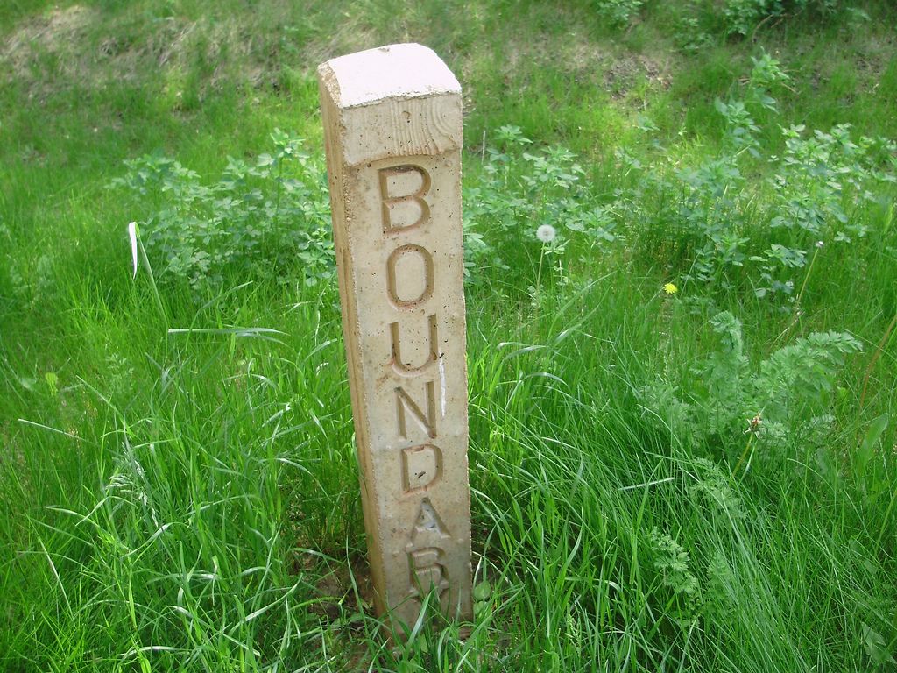
Self-centredness
Respect for others
Accept NO from others
Empathy ➔ Correction ➔ Consequence
Notes:
Children come to the world not knowing any boundary and thinking that others exist only for them. We have to help him get out of this disrespect for the boundaries of other people
Children need to learn not to hurt others, respect other people’s “No” without punishing them, respect limits, feel sad but not mad when other people’s boundaries prevent them from getting what they want.
Steps: Empathy ➔ Correction (e.g. “I understand that you‘re really disappointed but that’s not the way to talk to me. Calling me “Stupid” is not okay. How do you feel when someone at school talks to you like that? Well, that is how I feel as well when you do that to me. It hurts my feeling and I don’t like it either. It is okay to be sad or mad, but I won’t allow name calling”). Correction should be followed by an apology and changes but if this does not happen, and it is not self-correcting, consequence (connected to the trespass) should be applied.
Using empathy and allowing him to feel the pain of loneliness (relational consequence). We are only stating what the child did, the parent’s limit and the consequence without shaming him or putting him down. His freedom, choice and responsibility are preserved. The empathy keeps us out of power struggle with the child. He will soon get the picture that his protest is not going to move our limit or get a reaction out of us. Empathy along with reality leads to acceptance and the ability to move on.
For some children, we need to sit down and talk to them at time when the arguments are not happening

Slide 17
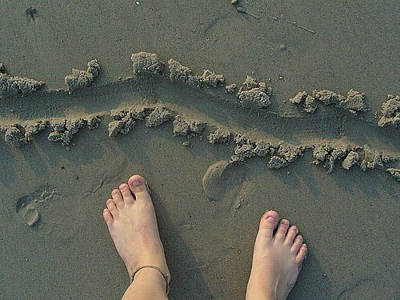
Healthy Separateness
Age-appropriate
Space
Time
Friends
Money
Clothing
Notes:
Let the child learns about healthy separateness from parents, give them age-appropriate freedom and not to require them be at our side at all times, so that we are teaching them to respect our boundary as well as we are respecting theirs. We also have to be separated from them e.g. our own nights out, our trips without them as they get older, our own space. Empathize with their frustration but keep the separateness.
Space: They could have their own space (e.g. their room vs. a mess) and live how they want to within limits but they have to be responsible for their freedom (e.g. if they keep a messy room and could not find things, don’t rescue them)
Time: We should not always nag our children to be on time. We are not a clock. Just tell them what time things happen and let them get ready on time. If they don’t, let them miss a few things or be late, they will soon learn what time really means. It is even better to let their peers punish them
Friends: if our children hang out with unwise choice of friends, talk with them. If their friends may be dangerous, we may need to act but find out reasons behind
Money: Let children learn that money is limited but stick to the boundary (e.g. “I know, I feel bad when I spend all of my money before the month runs out too. I have to go without things I need. I hate it when I do that”)
Clothing and Hair Style: Clothing usually says “I belong to the peer group” and “I am different from my parents and could make my own choice”. It should be their choice unless it endangers them. Generally real-world consequences will coach them. If their clothes are too weird, the school yard will tell them. Concentrate on more important things, e.g. values, skills, love, honesty and treatment of other people.
Process: Protest the limit ➔ try to change the limit and punish the one setting it ➔ as we hold on to the limit, apply reality and empathy ➔ children accept the limit and develop a more loving attitude towards it

Slide 18
Motive Development
Motive = do the right thing for the right reason
Fear of Consequence
Immature Conscience
Values and Ethics
Love God, Love Others
Notes:
Motives drive our behaviours. We want our children do the right things for the right reasons, not simply to avoid punishment, otherwise what will happen when we leave their side. This doesn’t work in the long run. That’s why many Christian parents are so frustrated when their freshman child engages in many activities never permitted at home. Stages of motive development: fear of consequences ➔ immature conscience ➔ values and ethics ➔ mature love, mature guilt (love God, love others). When we are setting boundaries, we have to provide our children with emotional contact, support and love. Reassure them how much we care and be with them in their joys and sorrows, even in their anger or disappointment in us. Love first, set limits second. Fear of Consequence: When we begin setting limits, our child will almost certainly test, protest and express hatred. But stick with our boundaries, be fair but consistent and empathize with our child’s emotional reactions. Eventually, our child will develop a healthy fear of consequences (but not fear of losing love). A new thought “I need to think about what I am preparing to do. What might it cost me?” replaces “I am free to do what I want when I want”. The child needs to learn that his problem and consequence is himself, he has impact on his future quality of life e.g. time out and not an enraged out-of-control parent (e.g. you make me feel mad). We just have to stick to our guns (limits) one more time than the child (**) and we will then win. Immature Conscience: When the child misbehaves, he begins speaking sharply or critically to himself as a harsh parent would. Internalization lets what is outside becomes internal. The child digests his experiences which form part of how he looks at life and reality. It shapes their conscience and helps them be aware of right and wrong. When the situation arises, the person who has been important to the child in that matter may come to mind. Don’t be too strict or abusive with them otherwise it may create a very harsh and immature conscience in the child who may either become depressed or guilty or rebellious. Balance between the two extremes: strict vs. pulling away the boundaries. Values and Ethics: The child may begin asking many value-laden questions e.g. Is this a bad word? Avoid the mistake of giving our child guilt and shame messages (e.g. I thought you were a Christian and you still do that). Kids easily fall into being good people because they want to avoid guilt or shame about themselves. Keep bringing them back to reality principles (e.g. that goes against what you and we believe), Mature love, mature guilt: Our child is created for relationship. Concern for this relationship becomes his most profound motive in life. Children now understand the right and wrong more from the relational point of view. This is right or wrong is shifted to “this hurts others or God”

Slide 19
No Pain No Gain
Hurt ~= Harm
How to Evaluate Pain ➔ Don’t let our child’s pain control our actions ➔ Keep our pain separate from our child’s pain ➔ Help child not to avoid pain but to make good use of it ➔ Ensure it isn’t pain of need/injury
Notes:
Hurt ~= Harm, Hurt = the child gets disciplined or feels sadness or wounded pride or the loss of something she values. Harm = actual injury by wounding her person, judging, attacking, abandoning or not providing something she needs.
4 rules of evaluating pain
Rule #1 Don’t let our child’s pain control our actions: The child who is never frustrated will never develop frustration tolerance. Frustration and painful moments of discipline help a child learn to delay gratification. If we are able to hold the limit and empathize with the pain, then character will develop. But if we don’t we will have the same battle tomorrow.
Rule #2 Keep your pain separate from your child’s: Sometimes parents identified with the sadness of their child to a point that was not real
Rule #3 Help your child see that life is not about avoiding pain but about making good pain an ally. We learn to do our chores when parents make not doing chores more painful than getting them done. The child who is taught to avoid pain altogether will encounter much more pain in life than necessary. Parents who step in and rescue their children from suffering will be replaced later in life with other codependent people, drugs, alcohol, eating disorders, shopping or other addictions. They have taught their children that frustration and adversity are not something to face and deal with, requiring change on their part, but something that can be made to go away in the immediate moment by using the “mother” of immediate gratification. We need to teach or model to our child that pain can be good
Rule #4 Make sure the pain is the pain of maturing, not the pain of need or injury: When an older child misbehaves, it may be some of these valid reasons (e.g. hurt feelings from parents / other people, anger in a relationship, trauma, loss of a parent, abuses, physical reasons, ADHD, depression, change in family style, structure or schedule, parents exercise too much control, parents discipline them with anger, parents not meeting their needs of love / attention / time, parents not commenting on their successes but failures, parents being too perfectionistic)
Evaluate our children’s pain. If they are in need or injured, run to their rescue. But if they are protesting reality’s demands for maturing to the next level, empathize with that struggle, manage it well, but let them go through it to the end.

Slide 20
Be Thankful
Entitlement = feel as if people owe him things or he is the centre of universe
Opposite of entitlement ➔ gratitude ➔ thankful for what they have ➔ cherish for what they receive
Limiting vs. Containing
Notes:
We need to help children to transform normal childhood envy into acceptance, gratitude, and contentment otherwise they will feel nothing is good enough or enough to fulfill them no matter what they achieve or receive.
Entitlement is when someone feels as if people owe him things or special treatment simply because he exists. And when they do not get what they want they feel that the one who is not giving it to them is wrong and protest as if they were a victim of bad treatment from the other person. They carry around a feeling of you should and they are always demanding something from someone. After a while, employers or spouses will get tired of such complaint / blame and even that person. Desire moves them to work. Envy just burns within.
The opposite of envy and entitlement is gratitude. It comes from the feeling of freely receiving things not because they deserve it but because someone has graced them with it. They feel a thankfulness grounded in love and cherish what they have received and feel that they are so fortunate to have what they have
Children experience two moms or two dads because sometimes we will fulfill their wish while other times, we do not provide what they want of which they see it as their entitlement. However, with a repeated combinations of gratification and frustration, eventually children will gain a secure sense of the world’s being not perfect in gratifying them all the time but good enough in giving them what they need. They even learn to love the one who both loves them and frustrates them.
Children that are never frustrated will not understand that they are not the centre of universe, that they are not owed whatever they want and that others do not exist only for their needs. They don’t see themselves as a victim when they are deprived and do not see others as bad when they do not do what they want. They develop a balanced view of themselves and others.

Slide 21
Steps to Implement Boundary
Realize there is a problem
Have a group / partner for support / accountability
Model boundaries to kids
Evaluate and plan ➔ child ➔ our own issues ➔ plan
Notes:
We need to respond to our child with empathy, firmness, freedom and consequences. We should get ready for a battle when we first start such a structure with our children so don’t ask our child for permission for implementing the plan, they surely won’t like it. Also, do not go to the other extreme but enforcing it with high pressure. It has a few steps
Step 1: See the 3 realities: - there really is a problem and our child is not perfect. Do not make up excuses for their misbehaviour. Some parents do it to avoid guilty feelings or they themselves are perfectionist or they feel their chid is victimized or they feel embarrassed or they don’t want to go through the effort of disciplining - the problem isn’t really the problem. The symptom alerts us to the inner problem but don’t just react to the symptoms.(e.g. doesn’t listen to instruction ➔ lack of fear of consequences or control other kids ➔ lack of respect for other’s boundary. - Time does not heal all. We should not assume the child will outgrow the problem. Time is only a context for healing but not the healing process itself.
Step 2: Plug in: - many parents lose the boundary battle simply because they are worn down by an actively resistant child. So it is wise to find or start a parenting group that works on boundary issues for trading tips, secrets, techniques, victories and failures.
Step 3: Grow in boundaries personally: - Before we start our child to practice boundaries, we need to show them as a role model. This will also help us to grow spiritually and emotionally ourselves and may even let us begin working on our own boundary issues.
Step 4: Evaluate and plan: A) Child (Age: be aware of the normal issues of our child’s age group, especially what she is capable of. The older the child, the more frustration she can tolerate) (Maturity level: this varies from child to child. Attachment ➔ is our child able to connect emotionally to us or does she see us as someone who cares for her? Honesty ➔ does our child tell the truth and not struggle with lying?) (Context: We need to understand her environmental influences. What is her life setting? Single parent family? Any clinical issues?) (Specific boundary conflict: is she having problems with family rules, school or friends?) (Severity: determine how profound the problem is. Don’t sweat the small stuff but address issues that involve honesty, responsibility, caring and morality.

Slide 22
Steps to Implement Boundary
Present the plan
Follow through ➔ empathy ➔ correction ➔ consequence
Pray God for wisdom
Notes:
B) Our own resources (Our own issues: observe how we react, avoid of ignore him. Work on whatever is broken in us that causes us to respond inappropriately) (Our life context: Look at our life’s realities e.g. emotional struggles, marital conflicts, job pressures. If we are in crisis, we need to get help for ourselves quickly. Single parent is playing 2 roles and it could be overwhelming, take initiative to find help and resources) (A boundary-resistant spouse: if our spouse doesn’t support boundaries, we need to address this with him before we begin serious work with our child otherwise we will always play the mean parent and the child will seek refuge from our spouse. Let the spouse handle the consequence e.g. teacher’s complaint. It is more than a parenting issue but a marriage issue) C) The Plan: write down the rules so that they can’t be questioned and it may be better to deal with 1-2 boundaries at the beginning. (The problem: state the issue in specific terms but stay away from character attacks that the child has to defend) (Expectation: make our expectation measurable so as to encourage improvement) (Consequences: write what will happen when the child doesn’t meet the expectations, he will lose privileges or have restrictions.)
Step 5: Present the plan: - Introduce the plan at a peaceful time (don’t pull out our papers in the middle of a screaming fight). - Take a “for” stance instead of an “against” stance (let her see that the problem is hurting her and others in her life and we want to deal with it because we love her and we want to do it together with her). - Present the problem in a specific way. - Present the expectation and make her know exactly what standards we expect. - Present the consequences (be bold and be direct. If she chooses to resist, the consequences will become a reality. Stay in control of the consequence and encourage her freedom to choose). - Negotiate what is negotiable (let the child have some input, within parameters on expectations and consequences. Giving on something minor may pay off. Let them realize that responsibility brings freedom. - Make expectations and consequences easily accessible (a notebook, bulletin board or posting on the fridge door is a good way to remind the expectations and consequences)

